Slide 1
Advanced C++ Internals: Chapter 20: C++ Polymorphism
ZACOCPPINT

Slide 2
Learning Journey:
Introducing Polymorphism
Processing Collections
Root Class
Override
Collection of unique_ptr
V-pointers
Lab #33
Polymorphism from a coding perspective
Lab #34
Polymorphism from a reverse engineering perspective
Summary
Appendices:
Useful links
Learning Outcomes:
Must be able to describe common polymorphic concepts
Should be able to identify polymorphic implementation artifacts in memory
Could be able to manipulate polymorphic implementation to alter code behaviour
Polymorphism

Slide 3
OOP has four recognised pillars that guide design and organization of code in any object-oriented solution.
These four are:
Encapsulation
Inheritance
Abstraction
Polymorphism
Polymorphism allows objects of different classes to be treated as objects of a common class.
Usually achieved via:
Function overloading
Virtual functions
Introducing
Polymorphism
Notes:
Object-oriented terminology can often be a barrier, so let’s break it down a little when we have the opportunity. ☺
Etymological note:
The term “Polymorphism” derives from two Greek words:
Poly (Πολύ): This Greek prefix means "many" or "multiple."
Morphē (Μορφή): This Greek word translates to "form" or "shape."
Therefore, it means “many shapes” or “many forms”.

Slide 4
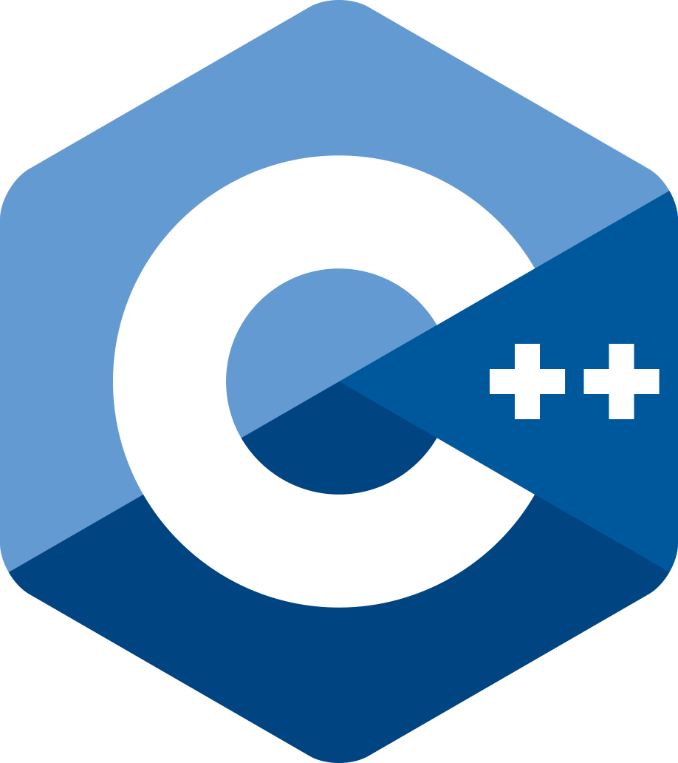
class Interruption {
public:
virtual void execute() = 0;
...
};
class Need_A_Tea : public Interruption { ... };
class Dog_Eats_Neighbours_Cat : public Interruption { ... };
class Team_Meeting : public Interruption { ... };
auto interruptions = vector<Interruption*>();
...
for (interruption : interruptions) {
interruption.execute();
}
Processing Collections
Notes:
We often need to apply some process to a collection of different-typed objects. There are a variety of ways to do this depending on the context and the programming language.
One of the simplest ways is to employ polymorphic classes. This makes use of a mechanism known as dynamic dispatch - which simply means choosing the function to call at run-time instead of at compile time.
For this to work in C++ we need a root-class (Interruption) from which we derive the various 'concrete' classes on which the common function (execute()) needs to be called.

Slide 5
class Interruption {
public:
// modifiers
virtual void execute() = 0;
virtual ~Interruption() = default;
protected:
Interruption(std::string_view name) : _name(name) {}
std::string _name;
};
Root Class
Requires a virtual destructor
usually defaulted
may have pure virtual functions
may have data
protected constructors if it is an abstract class.
Notes:
The root-class defines the common parts for all derived classes.
This usually consists of some public functions (the public interface) and some private data. There may also be private functions and protected functions and data. All of these are optional; the minimal root class is just a name!
The virtual keyword makes that function polymorphic.
An abstract class is one that describes an idea, rather than a constructible object. It must be derived-from before objects can be constructed. This is often expressed through pure functions.
If you want to force derived classes to provide their own implementation of a virtual function, you make it "pure" with `= 0;`
Pure functions do not have to have provide an implementation.
It is very likely that polymorphic objects will be destructed through base-class pointers. For this to work reliably, the destructor must be declared and made virtual. It can be defaulted.
You cannot construct an object of a class with a pure function - it must first be derived-from. So, the constructors are of no use in the public section. It is usual to make them protected.
-->

Slide 6
class Need_A_Tea : public Interruption {
public:
enum Blend {EARLGREY, BREAKFAST};
Need_A_Tea(std::string_view name, Blend blend ) : Interruption(name), _blend(blend) {}
void execute() override { std::cout << std::format("\n{} drinking {} tea\n\n", _name, blend()); }
std::string_view blend() const { return _blend == EARLGREY ? "Earl Grey" : "Breakfast"; }
private:
Blend _blend;
};
Override
override not required, but recommended
gets compiler to check it is specializing a virtual function
Notes:
In C++, the override keyword (as shown here with the “execute” method) is used to indicate that a member function of a derived class (“Need_A_Tea”) will override a virtual function declared in its base class (“Interruption”).
It’s optional as it’s primarily designed to improve the code clarity for the reader, but it can also catch certain types of error during compilation.

Slide 7
auto interruptions = vector<unique_ptr<Interruption>>();
Safe owning collection of base-class pointers
Populate using make_unique <derived-class>
Cannot use aggregate initialisation (initializer_list) with unique_ptr
initializer_list makes copies of its members
unique_ptr cannot be copied
Collection of unique_ptr
interruptions.push_back(make_unique<Need_A_Tea>("Stephen", Need_A_Tea::EARLGREY));
Notes:
Polymorphism makes use of Liskov substitution: "a derived-class may be substituted where a base-class is expected".
We can have a collection of base-class typed pointers which point to derived-class objects.
We can then iterate over the collection and call base-class declared functions. Those which are virtual will employ dynamic-dispatch and the derived-class implementations will be used. Thus, each object behaves differently - hence polymorphism.
If the collection owns the objects, we use unique_ptr to manage the object lifetime. A non-owning collection would use raw pointers.

Slide 8
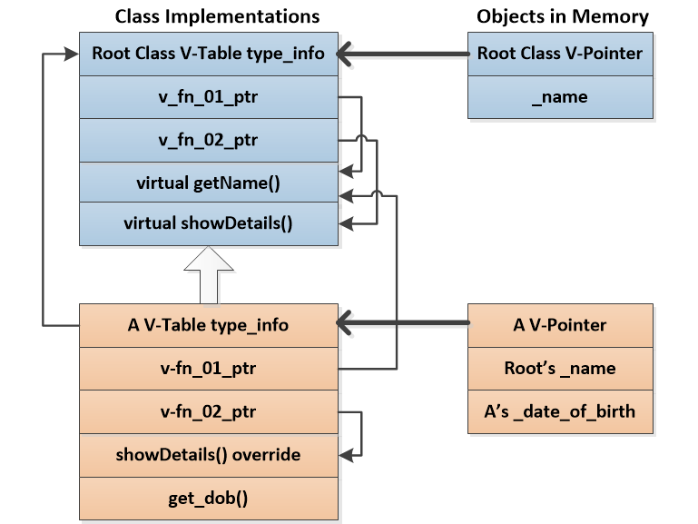
v-pointers
Notes:
When an ordinary function is called, the compiler knows where the implementation code is, so it inserts a jump-instruction to that location and passes in the arguments (including the object address if it is a member-function).
For polymorphic function-calls the compiler does not know which derived-type object the pointer points to, and so cannot directly jump to the function code. This is where Dynamic-Dispatch comes into play.
Ordinary objects consist only of the data-members of the class. There is no class-id information to enable the run-time to discover what type the object is.
To enable dynamic-dispatch to work, every polymorphic object is given a v-pointer (usually as its first data-member). This points to a table of information (the v-table) that identifies the class.
Only polymorphic classes have v-tables. The V-table has a function-pointer entry for each polymorphic function.
If this class implements a specialisation for the virtual function, it points to it, otherwise it will point back to a base-class implementation.
The v-table also contains the class type_info (possibly via another pointer). type_info provides the class-name (possibly mangled, or some kind of hash) and pointers to the base-classes. This is used by RTTI.
When a polymorphic function call is made, the object v-pointer is followed to the class v-table. The compiler applies an offset to this pointer to pick the required virtual function-pointer. This function-pointer is then followed to the implementation.

Slide 9
C++ Internals Lab #33
Polymorphism (coding perspective)
Notes:
This lab focuses on using classes from a coding perspective

Slide 10
C++ Internals Lab #34
Polymorphism (reverse engineering perspective)
Notes:
This lab focuses on classes – from a reverse engineering perspective

Slide 11
Polymorphism is one of the four key pillars of OOP
means “many forms”
The root-class defines the common parts for all derived classes.
typically consists of some public functions (the public interface) and some private data
An abstract class is one that describes an idea, rather than a constructible object.
Overriding virtual methods by derived classes is a common example of polymorphism
Allows us to iterate over diverse objects, call the same method, get different results/actions
Override keyword is optional; improves code clarity
Polymorphism makes use of Liskov substitution
The V-table has a function-pointer entry for each polymorphic function
Summary

Slide 12
Any questions?

Slide 13
Appendices
Notes:
Some additional information you may find useful…

Slide 14
Websites and online resources
GCC, the GNU Compiler Collection (no date) GCC, the GNU Compiler Collection - GNU Project. Available at: https://gcc.gnu.org/ (Accessed: 16 November 2023).
Clang 18.0.0git documentation (no date) Clang Compiler User’s Manual - Clang 18.0.0git documentation. Available at: https://clang.llvm.org/docs/UsersManual.html (Accessed: 18 December 2023).
C++ Standard Library (no date) cppreference.com. Available at: https://en.cppreference.com/w/cpp/standard_library (Accessed: 16 November 2023).
JTC1/SC22/WG21 - The C++ Standards Committee - ISOCPP (no date) . Available at: https://www.open-std.org/jtc1/sc22/wg21/ (Accessed: 16 November 2023).
Useful resources

Slide 15
Review of Chapter’s Learning Outcomes

Slide 16
Learning Outcomes:
By the completion of this chapter, you…
Must be able to describe common polymorphic concepts
Should be able to identify polymorphic implementation artifacts in memory
Could be able to manipulate polymorphic implementation to alter code behaviour
Please review these learning outcomes at chapter's end.
Learning Outcomes

